Slide 1
Project Elaboration Phase 1
Presented By:
Ger Xiong
J’enderson Xiong
Liz Wronski

Slide 2
Vision
Since there are many components involved in a functioning catering company, there needs to be a centralized system for organization and communication.
We want to create a management system to process catering orders and organize them in a way for multiple entities of the catering team to access and use.

Slide 3
Scope
The catering management system will allow for customer orders to be effortlessly entered into an database where the information can then be accessed by other users of the system. In-depth Information about each order will be communicated through the system.

Slide 4
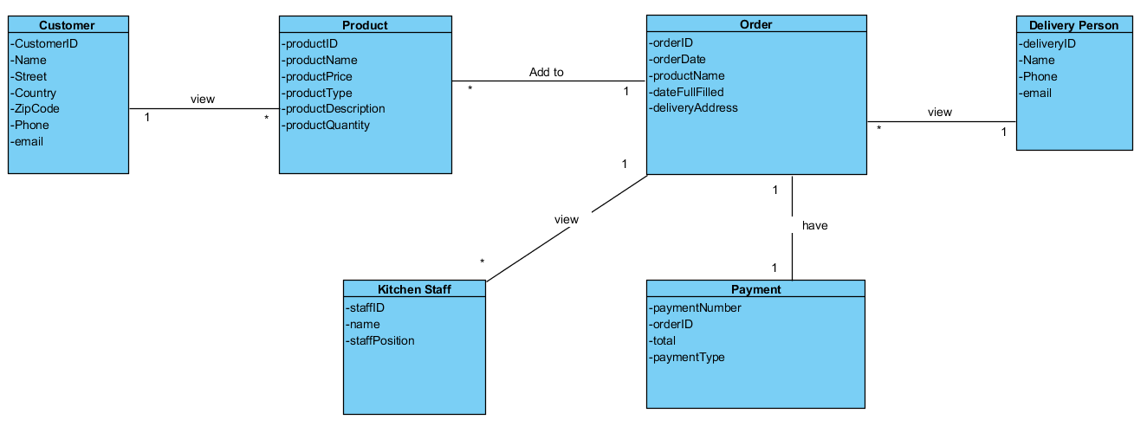
Domain Model

Slide 5
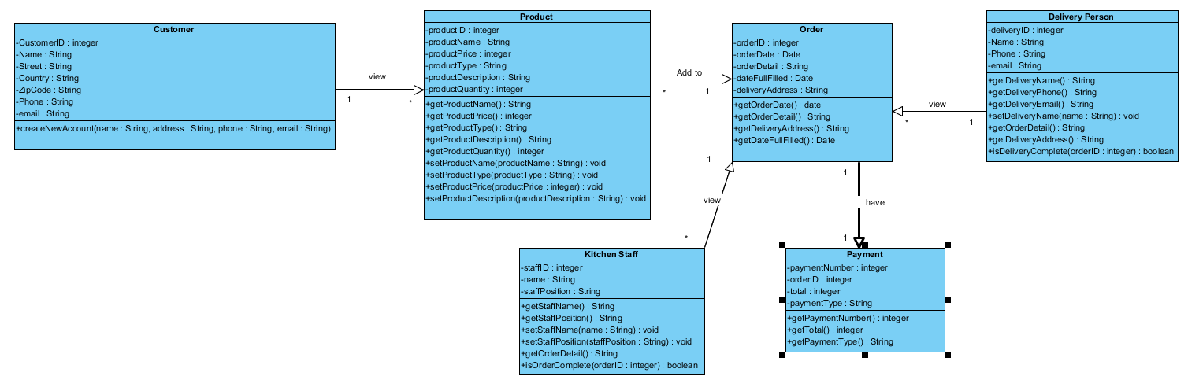
Design Model

Slide 6
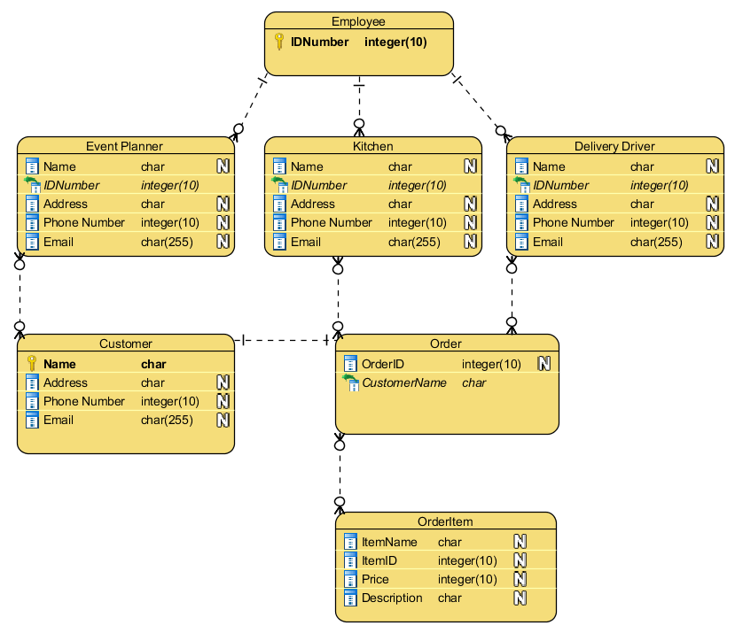
Data Model

Slide 7
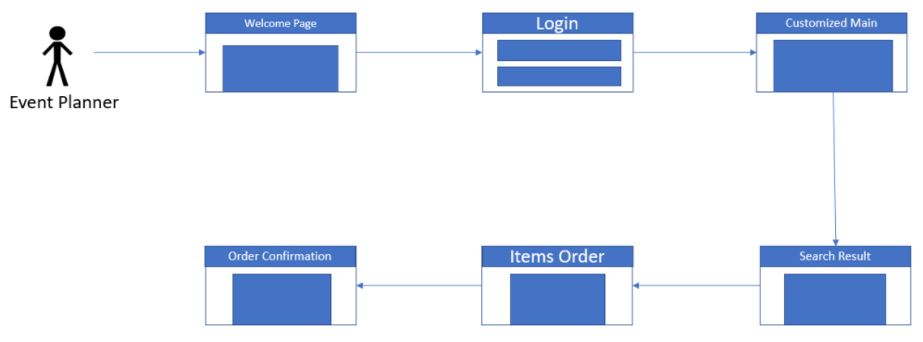
Use Case Storyboard ____________ Event Planner

Slide 8
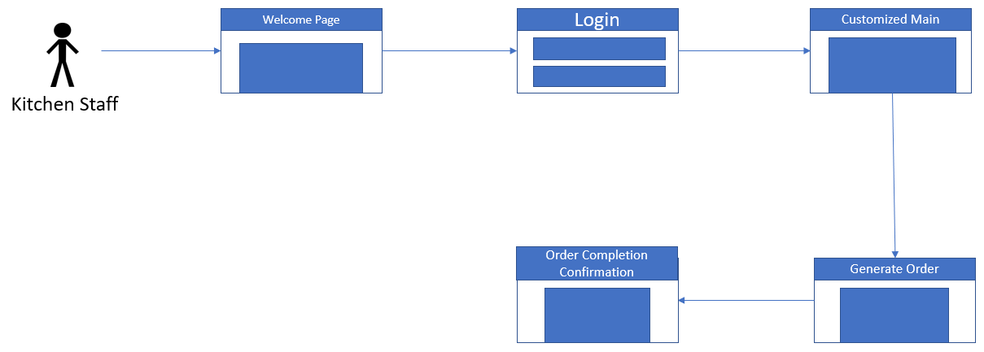
Use Case Storyboard ____________ Kitchen

Slide 9
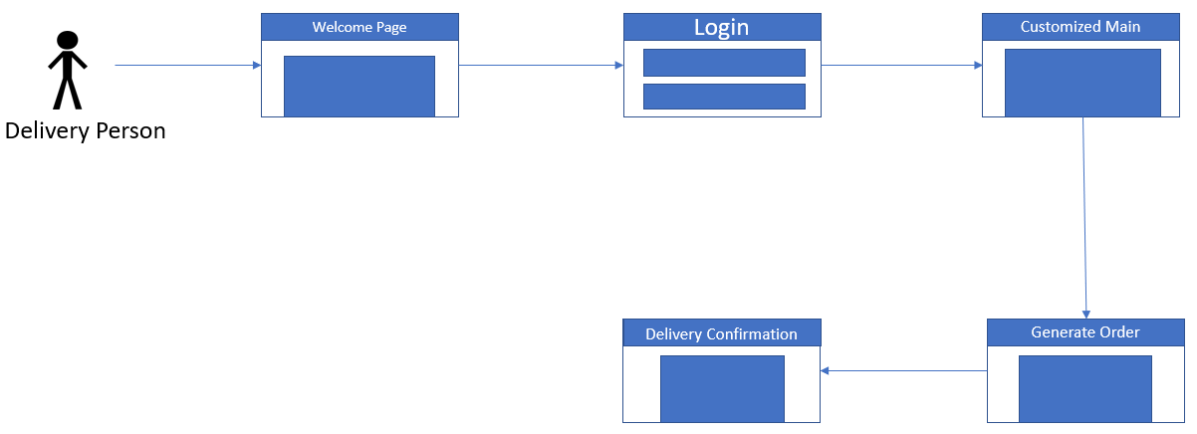
Use Case Storyboard ____________ Delivery Driver

Slide 10
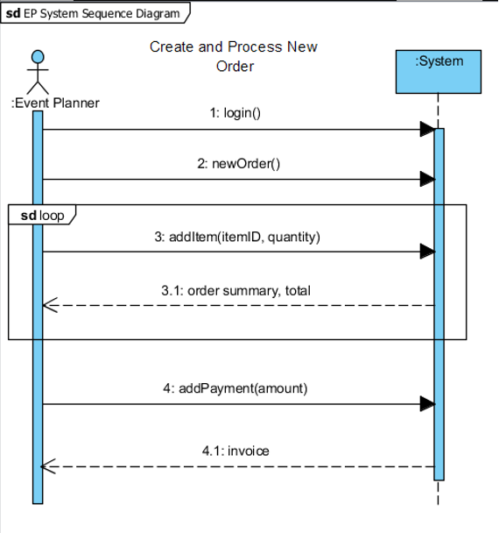
System Sequence Diagram Event Planner

Slide 11
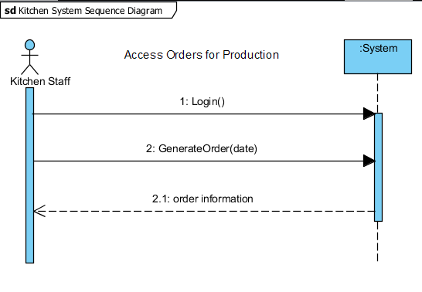
System Sequence Diagram Kitchen

Slide 12
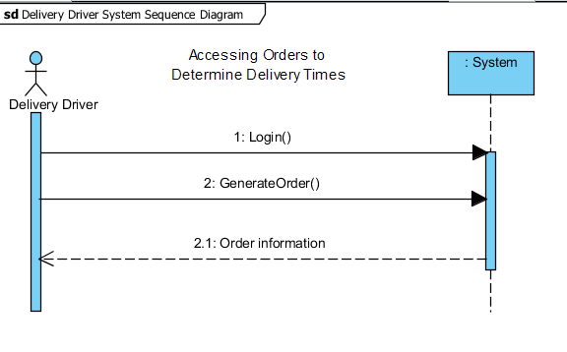
System Sequence Diagram Delivery Driver

Slide 13
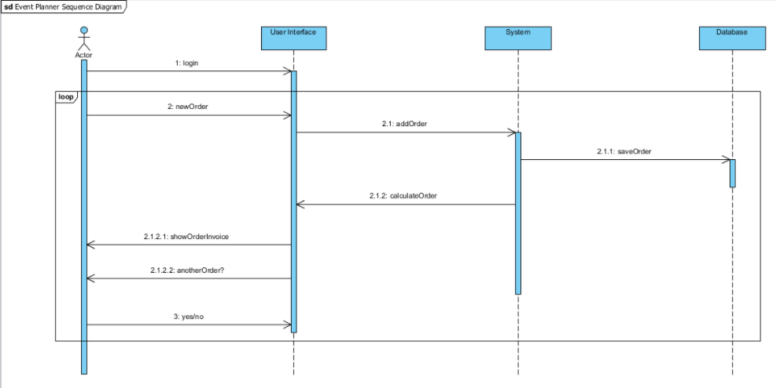
Sequence Diagram ___________ Event Planner

Slide 14
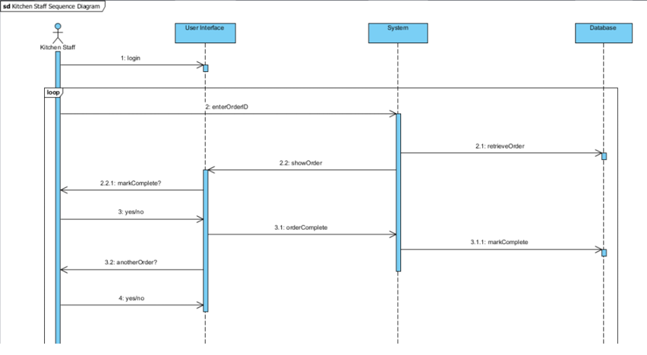
Sequence Diagram __________ Kitchen

Slide 15
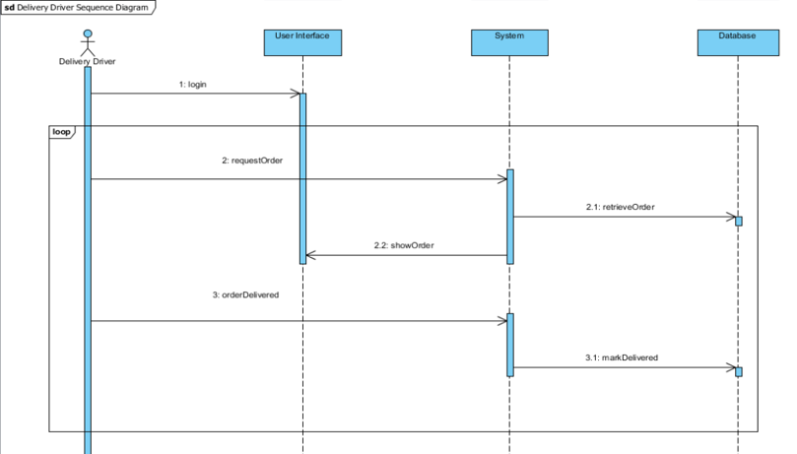
Sequence Diagram ____________ Delivery Driver

Slide 16
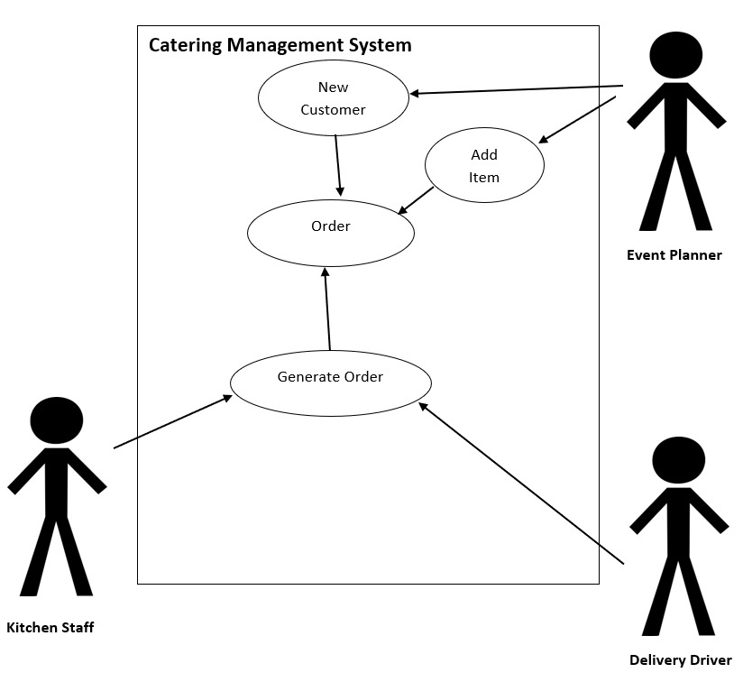
Updated Use Case

Slide 17

Questions

